Slide 1


GPS

Slide 2
GPS Satellites
Overview of GPS

Slide 3
GPS Satellites
XGPS

Slide 4

GPS Spooﬁng – Step 1
Plugin and ensure HackRF is working
Plugin hackRF
Ensure hackRF is connected
hackrf_info

Slide 5
Backup - Install gps-sdr-sim
git clone https://github.com/osqzss/gps-sdr-sim.git
cd gps-sdr-sim/
gcc gpssim.c -lm -O3 -o gps-sdr-sim

Slide 6
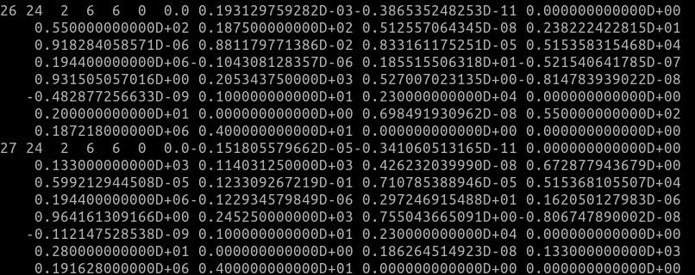
GPS Spooﬁng – Step 2 Download latest GNSS archive
Go to https://cddis.nasa.gov/archive/gnss/data/daily/2024/brdc/
Download the latest archive from today (brdc0370.24n)
Place the ﬁle in /usr/src/gps-sdr-sim directory

Slide 7
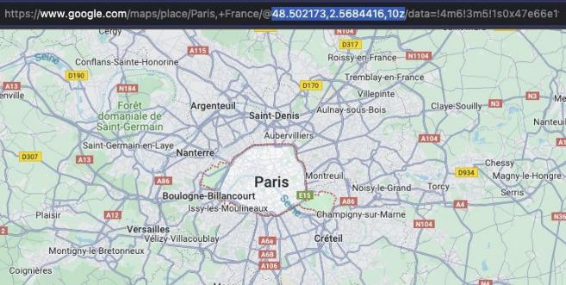
GPS Spooﬁng – Step 3 Select a location to spoof
Navigate to maps.google.com
Find a location to spoof
Copy the longitude and latitude from the URL

Slide 8
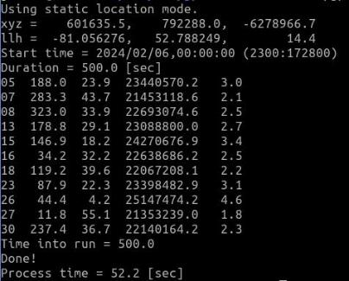
GPS Spooﬁng – Step 5 Generate constellations
Go to gps-sdr-sim
cd /usr/src/gps-sdr-sim
Run the following command
./gps-sdr-sim -e brdc2050.23n -l -81.056276,52.7882491,17z -b 8 -d 500

Slide 9
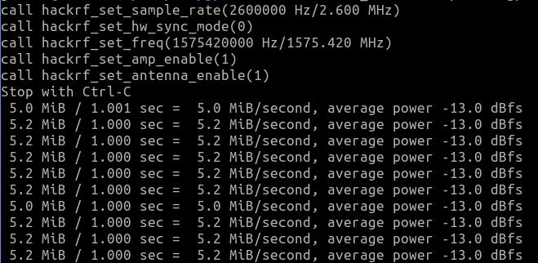
GPS Spooﬁng – Step 6 Transmit Spoofed GPS Location
1. Run the following command
hackrf_transfer -p 1 -t gpssim.bin -f 1575420000 -s 2600000 -a 1 -x 30

Slide 10
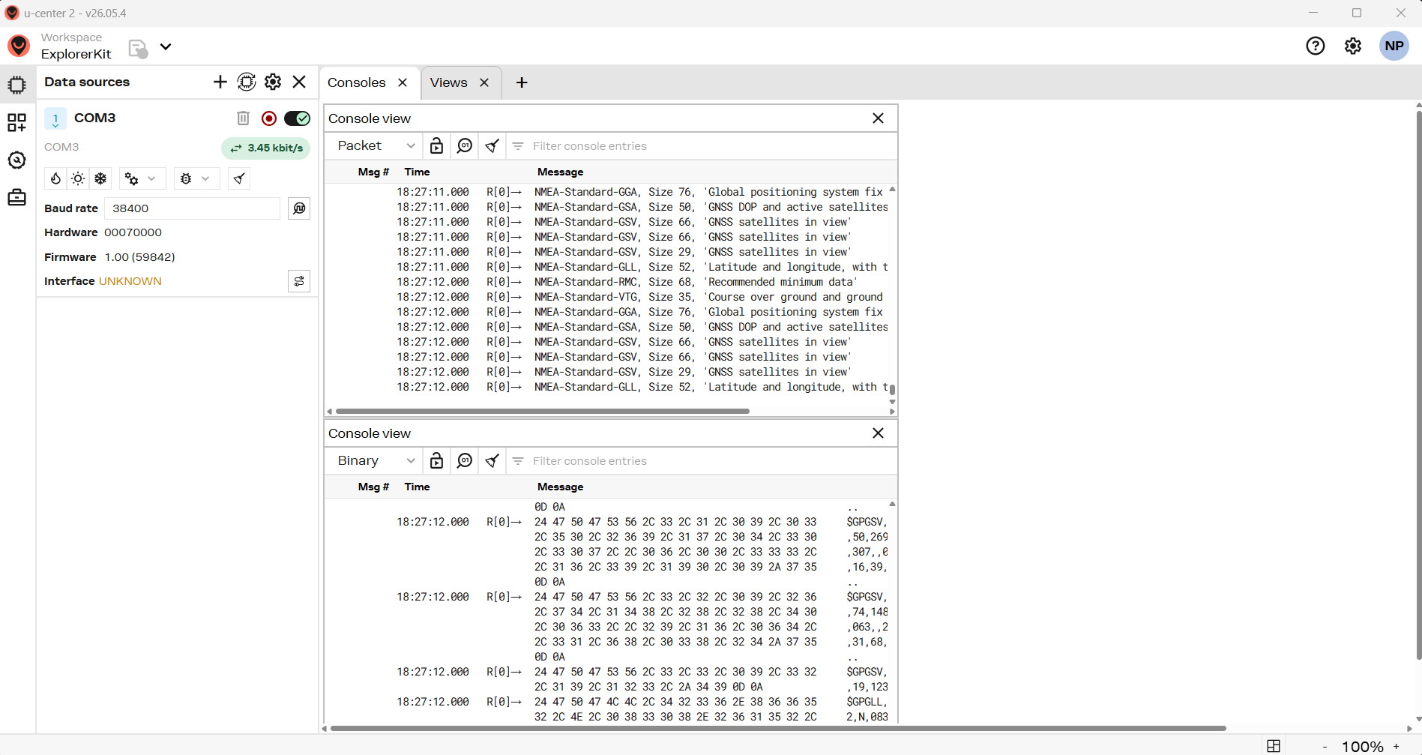
GPS Installation
Install U-Center2 from https://www.u-blox.com/en/u-center-2
May need to register as a user
Add COM# serial port as a source

Slide 11
GPS Messages
GPS Messages
  Text messages in ASCII sent by serial port to you
  Many message types
  Show satellite constellation
  Give you position and movement
Where are we?
  Latitude & Longitude

Slide 12
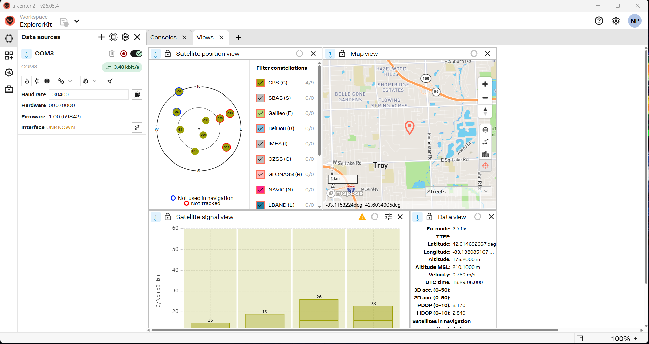
GPS View
See the constellation and where you are

Slide 13
GPS Satellites
GPS Constellations
  US GPS with SBAS corrections
  European Galileo
  Chinese BeiDou
  Russian GLONAS

Slide 14
GPS Information
Basics
  Global Navigation Satellite System (GNSS)
  https://en.wikipedia.org/wiki/Global_Positioning_System
  https://www.gps.gov/
  Used for Navigation
  Critical for Automated Driving and V2X Safety
    Need lane level resolution of at least 1.5m using WAAS
  1575.42Mhz, 1227.60Mhz, 1.023Mhz
  Weak signal, easily jammed (jamming devices are illegal)
  NDGPS stations retired by 2020, WAAS
GPS Augumentation
  https://en.wikipedia.org/wiki/GNSS_augmentation
  https://en.wikipedia.org/wiki/Wide_Area_Augmentation_System
  https://www.novatel.com/an-introduction-to-gnss/chapter-5-resolving-errors/satellite-based-augmentation-systems/
  http://gpsworld.com/5g-cellulars-next-step-brings-new-positioning-capabilities/

Slide 15
GPS Security
Interference
  Typically environmental
  https://www.gps.gov/spectrum/
  https://www.gps.gov/news/2012/03/solarstorm/
Jamming
  Is illegal
  https://www.gps.gov/spectrum/jamming/
  http://gpsworld.com/tag/gps-jamming/
  https://www.thesignaljammer.com/pages/How-GPS-Jammers-Work.html
  https://gizmodo.com/jamming-gps-signals-is-illegal-dangerous-cheap-and-e-1796778955
Spoofing (broadcasting false information)
  Is also illegal
  https://www.gps.gov/multimedia/presentations/2016/04/APEC/alexander-2.pdf
  https://en.wikipedia.org/wiki/Spoofing_attack#GPS_spoofing
  https://www.schneier.com/blog/archives/2017/09/gps_spoofing_at.html
  https://www.spirent.com/Blogs/Positioning/2015/September/GPS_Spoofing_Is_a_Real_Threat
  https://www.spirent.com/Blogs/Positioning/2017/September/DEFCON-25
  https://www.digitaltrends.com/mobile/gps-spoofing/

